Slide 1



Slide 2
What is XG Boosting Algorithm ?
Extreme Gradient boosting regression builds a strong predictive model by sequentially adding weak models (like decision trees). Each model attempts to correct the errors of the previous ones, using gradient descent to minimize the loss function and improve performance.

Slide 3
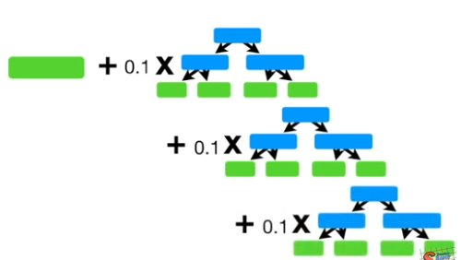
1 Leaf
(Average Weight of the Dependent variable)
+
Learning rate (0 – 1)
*
Fixed Trees (Any depth)

Slide 4
Steps Involved in XG Boosting
Calculate the average of the dependent variable – Leaf
Calculate the Residuals
Residuals = Dependent Variables – Average of Dependent Variable
Build the Fixed Trees for predicted residuals.
Replace the residuals with their average.
Introduce the 'Learning Rate" which ranges between 0 & 1
Average of Dep.Variable + Learning Rate * Residuals
Predicted new set of variables
Repeat the process from Step 3 to Step 8 untill we get the Good Results.

Slide 5
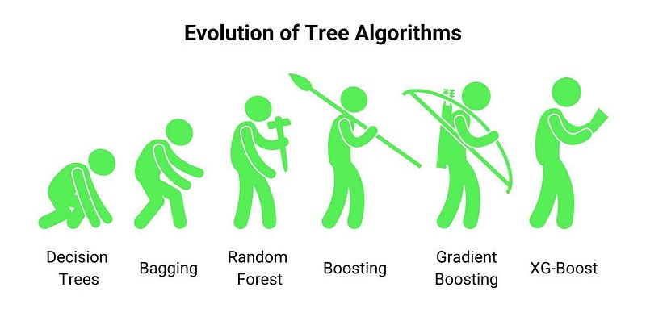

Slide 6
Applications of XG Boost
Finance: Credit scoring, fraud detection.
Healthcare: Disease diagnosis, patient outcome prediction.
Marketing: Customer churn prediction, recommendation systems.
Retail: Sales forecasting, product recommendations.
Insurance: Claims prediction, fraud detection.
Sports: Game outcome and player performance prediction.
Manufacturing: Predictive maintenance, demand forecasting.
NLP: Sentiment analysis, text classification.
Energy: Consumption prediction, smart grid optimization.

